Slide 1
OOP in Java
Presented By: Mirazul Islam Adjunct Lecturer, NUB

Slide 2
Basic Concepts of OOP
Object
Class
Encapsulation
Inheritance
Abstrac
tion
Polymor
phism

Slide 3
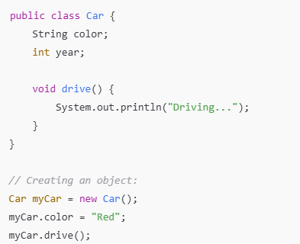
Objects and Classes
Classes:
Blueprint for objects.
Define attributes (fields) and behaviors (methods).
Objects:
Instances of classes.
Created using the new keyword.

Slide 4
Constructors in Java
A constructor is a special method used to initialize objects
It has the same name as the class
It is automatically called when an object is created
Syntax:
ClassName() {
// initialization code
}

Slide 5
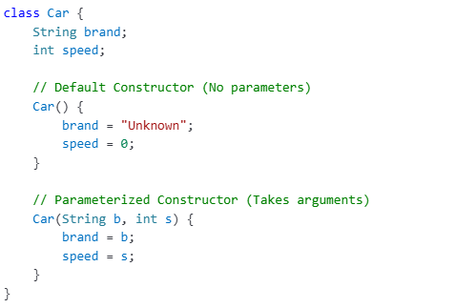
Default vs. Parameterized Constructors
- Default Constructor: No parameters
- Parameterized Constructor: Takes arguments to initialize values

Slide 6
Access Modifiers
public: Accessible from anywhere
private: Accessible within the same class only
protected: Accessible within the same package and subclasses
default: Accessible within the same package

Slide 7
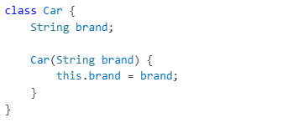
The 'this' Keyword
- Used to refer to the current object
- Avoids confusion between instance variables and parameters

Slide 8
Abstraction
Hides implementation details and only exposes the essential functionalities.
Ways to Achieve Abstraction in Java.
Abstract classes
A class with abstract methods.
Interfaces
Allow multiple inheritance.
Can’t be instantiated.

Slide 9
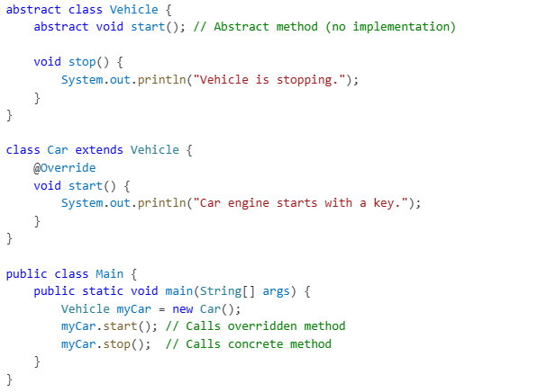
Abstract Classes
Useful when classes share common behavior but also require some unique implementation.

Slide 10
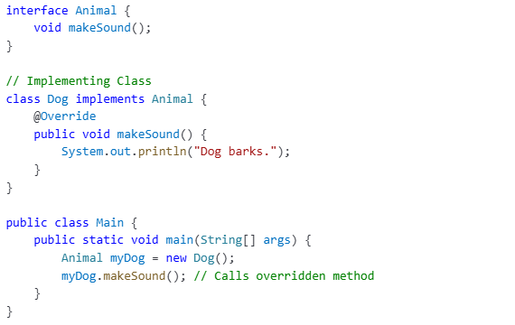
Interfaces
A class can implement multiple interfaces, unlike inheritance.

Slide 11
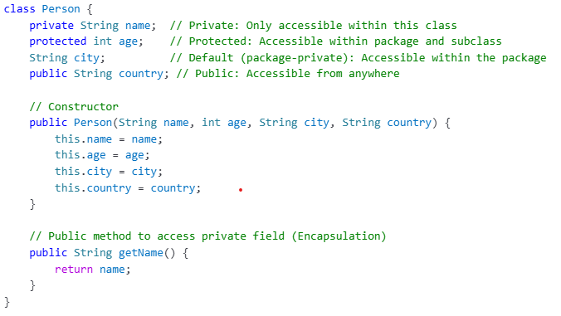
Encapsulation
Wrapping of data and functions into a single unit

Slide 12
Inheritance
A child class (subclass) inherits properties and behaviors (methods) from a parent class (superclass).
Types of Inheritance in Java
Single Inheritance
Multilevel Inheritance
Hierarchical Inheritance
Multiple Inheritance(via interface)

Slide 13
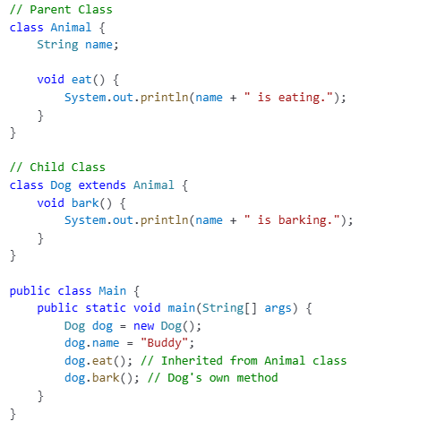
Single Inheritance
Base Class
Clild Class

Slide 14
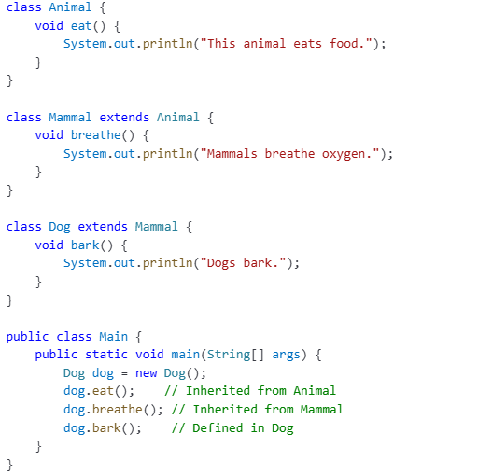
Multilevel Inheritance
Base Class
Intermediate Class
Derived Class

Slide 15
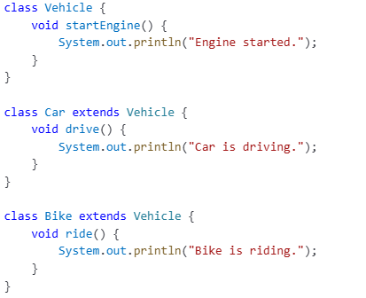
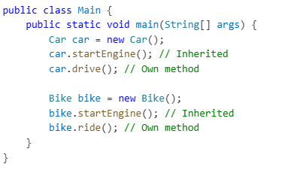
Hierarchical Inheritance
Base Class
Derived Class
Derived Class

Slide 16
Polymorphism
allows a single interface to represent multiple behaviors.
Types of Polymorphism in Java.
Compile-time Polymorphism(Method Overloading)
multiple methods with the same name but different parameters.
Run-time Polymorphism(Method Overriding)
The method call is resolved at compile time(static binding).
Same method name, same parameters but defer in subclass.
The method call is determined at runtime(dynamic binding).

Slide 17
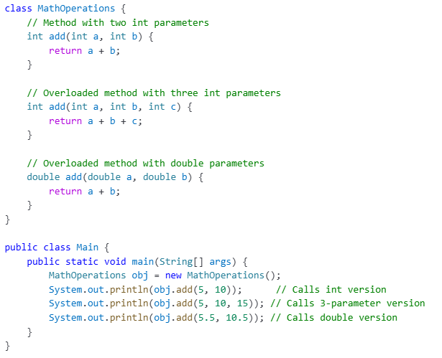
Method Overloading

Slide 18
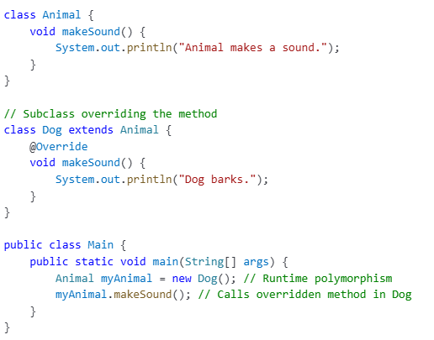
Method Overriding

